Slide 1


Slide 2

Agenda
What is JIRA
JIRA Features
JIRA Versions
JIRA Concepts
Projects
Project Templates
Issues
Workflow

Slide 3
What is JIRA
JIRA is a tool developed by Australian Company Atlassian in 2002.
JIRA lets you prioritize, assign, track, report and audit your 'issues', from software bugs and helpdesk tickets to project tasks and change requests.
More than just an issue tracker, JIRA is an extensible platform that you can customize to match your business processes.
JIRA improves productivity by cutting down on time wasted on tracking issues and coordination.
JIRA improves quality by ensuring all tasks are recorded down with all the details and followed up till completion.

Slide 4
JIRA Features
Issue Tracking: Allows teams to create, track, and manage issues or tasks throughout the project lifecycle.
Customizable Workflows: Users can define and customize workflows to match their team's processes and methodologies.
Agile Boards: Supports both Scrum and Kanban boards, providing visual representations of work items, sprints, and progress.
Dashboards: Customizable dashboards provide a snapshot of project status, progress, and key metrics, helping teams stay informed.
Advanced Searching and Filtering: Robust search and filtering capabilities enable users to find specific issues, create custom queries, and generate detailed reports.
Reporting and Analytics: Provides a variety of built-in reports and analytics tools to gain insights into team performance, progress, and bottlenecks.

Slide 5
Integration with Other Atlassian Tools: Seamless integration with other Atlassian products like Confluence, Bitbucket, and Trello for enhanced collaboration and functionality.
Version Control Integration: Integration with version control systems like Git allows for better code management and traceability.
Permissions and Security: Granular permissions and security settings to control access to sensitive information and ensure data integrity.
Automation Rules: Automation features to streamline repetitive tasks, improve efficiency, and reduce manual effort.
Scalability: Designed to scale from small teams to large enterprises, accommodating the growth and complexity of projects.
Mobile Accessibility: Accessible via mobile devices, ensuring teams can stay connected and productive on the go.

Slide 6
JIRA Versions
JIRA Software
JIRA Align
JIRA Work Management
JIRA Service Management

Slide 7
JIRA Software :
Mostly 90% of the companies use JIRA Software.It is developed for Software developers.
JIRA Align :
It is JIRA at an enterprise scale. It is designed to go beyond what JIRA software can do and scales up to handle things like financial allocations across different teams ,letting different teams use different frameworks or even letting you design new processes.
JIRA Work Management :
It is a non dev version of JIRA. It is more of a general office type project management. It contains Lists and calendars that Atlassian targets non dev teams like Marketing, HR etc.
JIRA Service Management :
Used to be called as a JIRA Service desk. It is more of a like a customer support.

Slide 8
JIRA Basic Concepts
Project
Issue
Workflow

Slide 9
What is JIRA Project?
A JIRA project is a collection of issues and is defined according to your organization's requirements.
For example, a JIRA project could be:
a software development project
a marketing campaign
a helpdesk system
a leave request management system a website enhancement request system

Slide 10
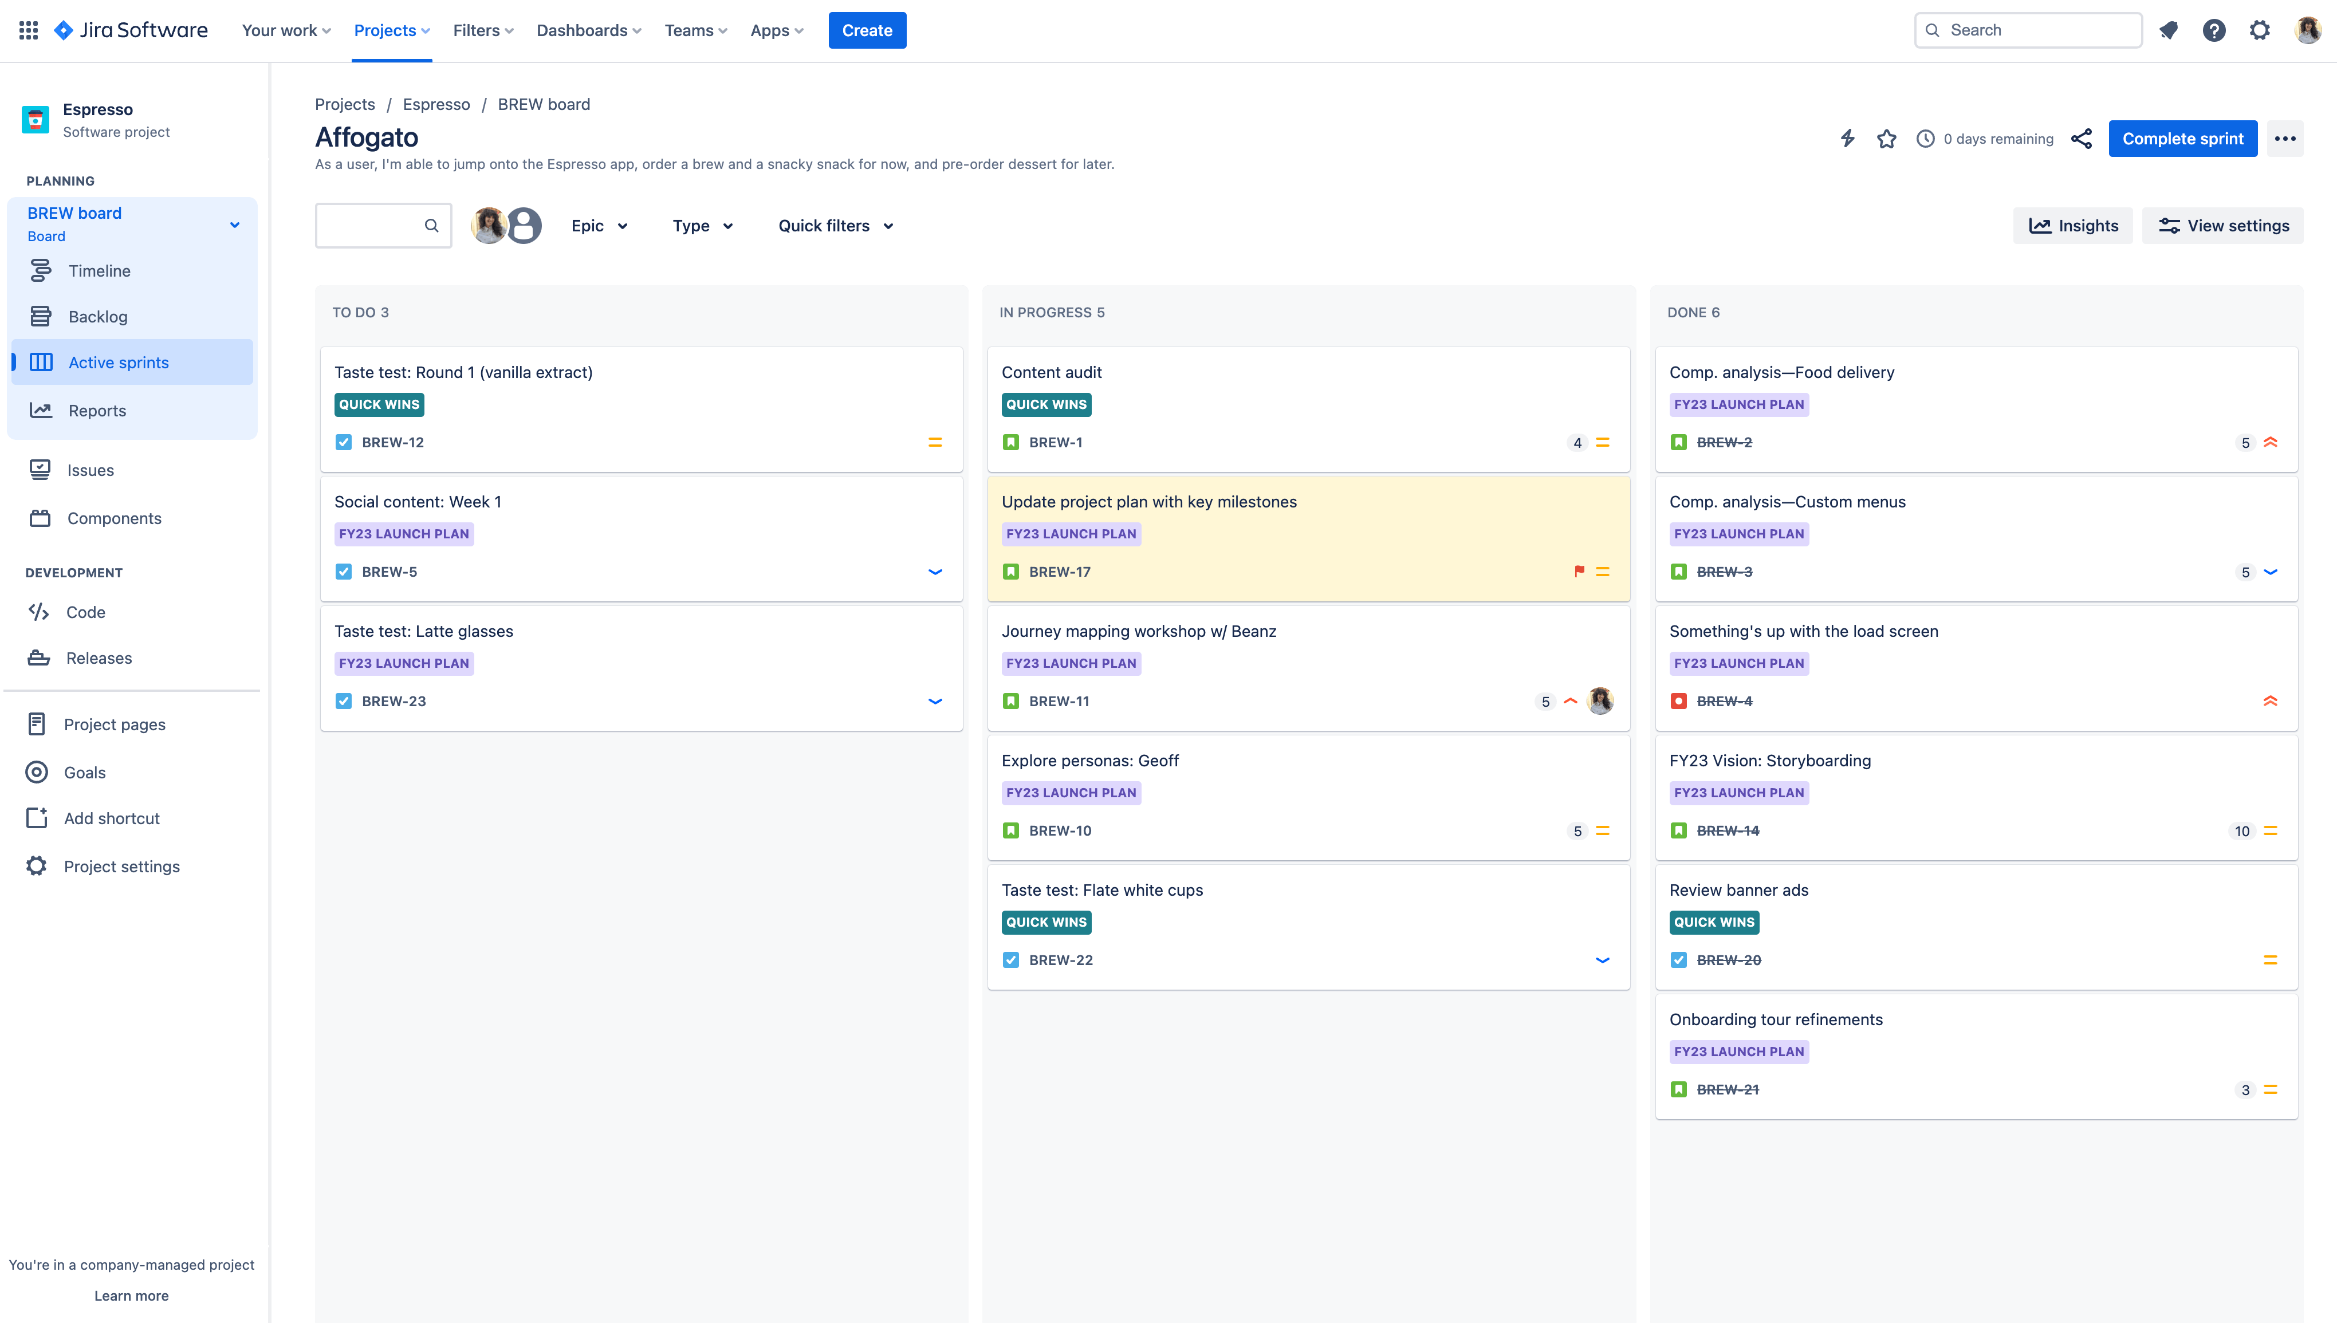
Board of a project to track changes

Slide 11
Types of Projects in JIRA
Team Managed Projects
Company Managed Projects

Slide 12
Team Managed Projects
Company Managed Projects
It has Global scope entities.
Must be created by JIRA Admin
It is more complicated to setup and maintain.
If we create a company managed project, we cannot change it to team managed project and vice versa.
It has project scope entities.
It doesn’t require special permissions to create.
It is very fast and easy to setup and maintain.

Slide 13
Project Templates
Jira Software comes with a variety of project templates to help teams get set up quickly by creating projects tailored to a specific team or use. These templates include pre-configured issue types, workflows and other features relevant to their type.
Commonly used project Templates are
Scrum
Kanban
Bug Tracking

Slide 14
Scrum sprints toward your project goals with a board, backlog, and roadmap. It’s best suited for teams that deliver work on a regular cadence or connect work across their tools. Scrum template has sprints.
A sprint is a predetermined amount of time where teams determine what work is going to get done in that time
Kanban visualizes and advances your project forward using issues on a powerful board. it’s designed for teams that control work volume from a backlog or connect work across their tools. It doesn’t have sprints. It is like an ongoing process.
Bug tracking manages a list of development tasks and bugs. It’s best suited for teams that are capturing, tracking, and resolving bugs.

Slide 15
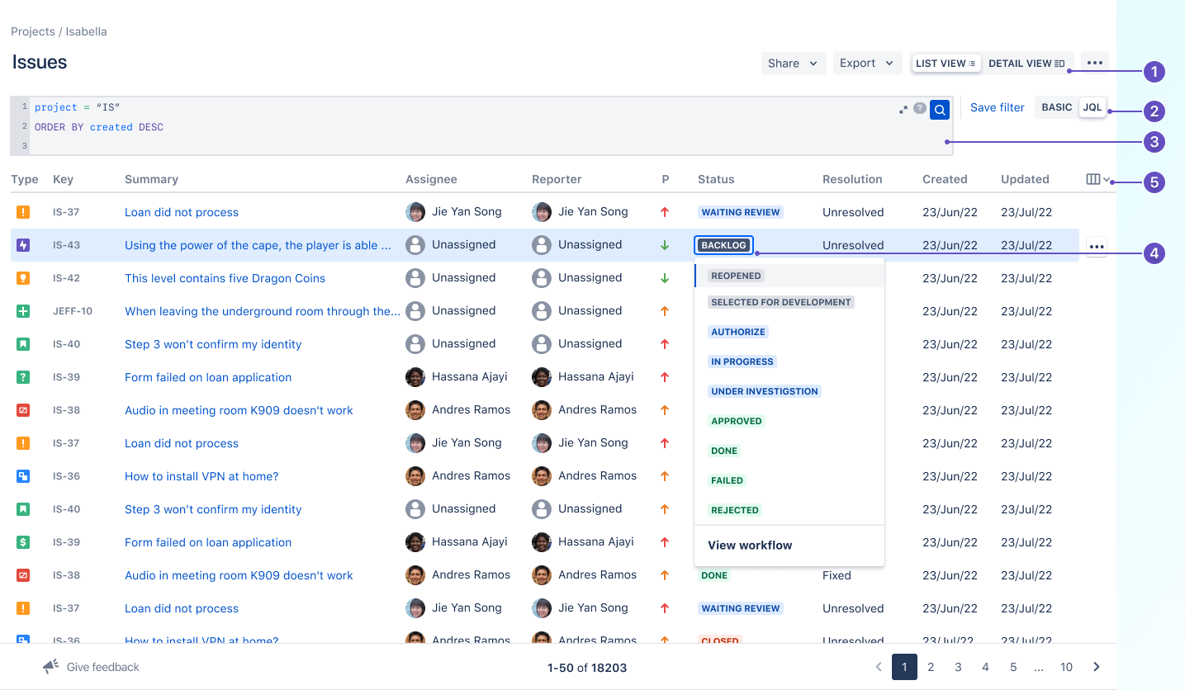
What is JIRA Issue?
An issue represents an action that has to be done. That action can be a task, a bug, a feature request or any type of action your organization might need to work with.

Slide 16
JIRA Issue Types
JIRA can be used to track many different types of issues. The default types are listed below, but please note that your JIRA administrator may have customized this list to suit your organization.
Bug - A Problem which impairs or prevents the function of the Product.
Story - A user story is the smallest unit of work that needs to be done.
Task - A task represents work that needs to be done.
Epic - A big user story that needs to be broken down. Epics group together bugs, stories, and tasks to show the progress of a larger initiative

Slide 17
Issue Priority
An issue's priority indicates its relative importance. The default priorities are listed below; note that both the priorities and their meanings can be customized by your JIRA administrator to suit your organization.
Highest - Highest priority. This problem will block progress.
High - Indicates that this issue is causing a problem and requires urgent attention.
Medium - Indicates that the issue causes a significant impact.
Low - Indicates that this issue has a relatively minor impact.
Lowest - Lowest priority.

Slide 18
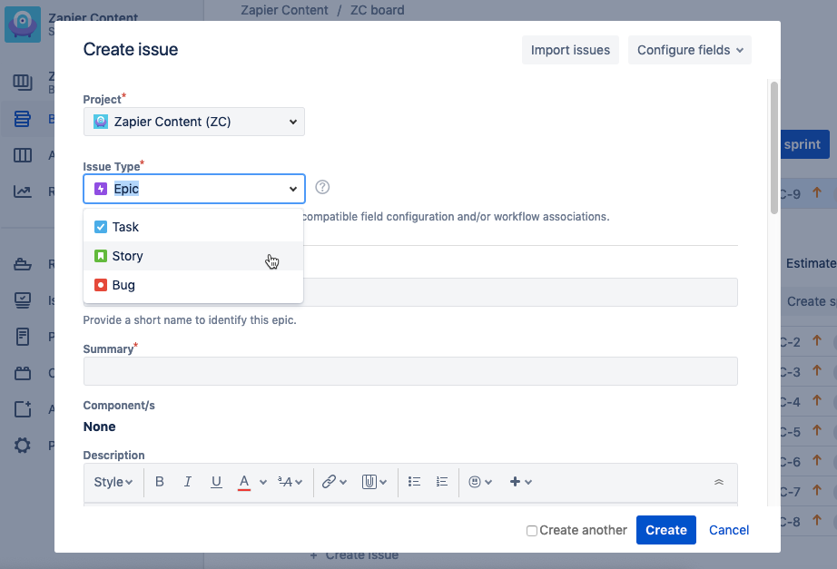
Creating a new issue in JIRA

Slide 19
JIRA Workflow
A JIRA workflow is a set of statuses and transitions that an issue moves through during its lifecycle and typically represents processes within your organization. There are default built-in workflows that cannot be edited; however, you can copy and use these workflows to create your own.

Slide 20
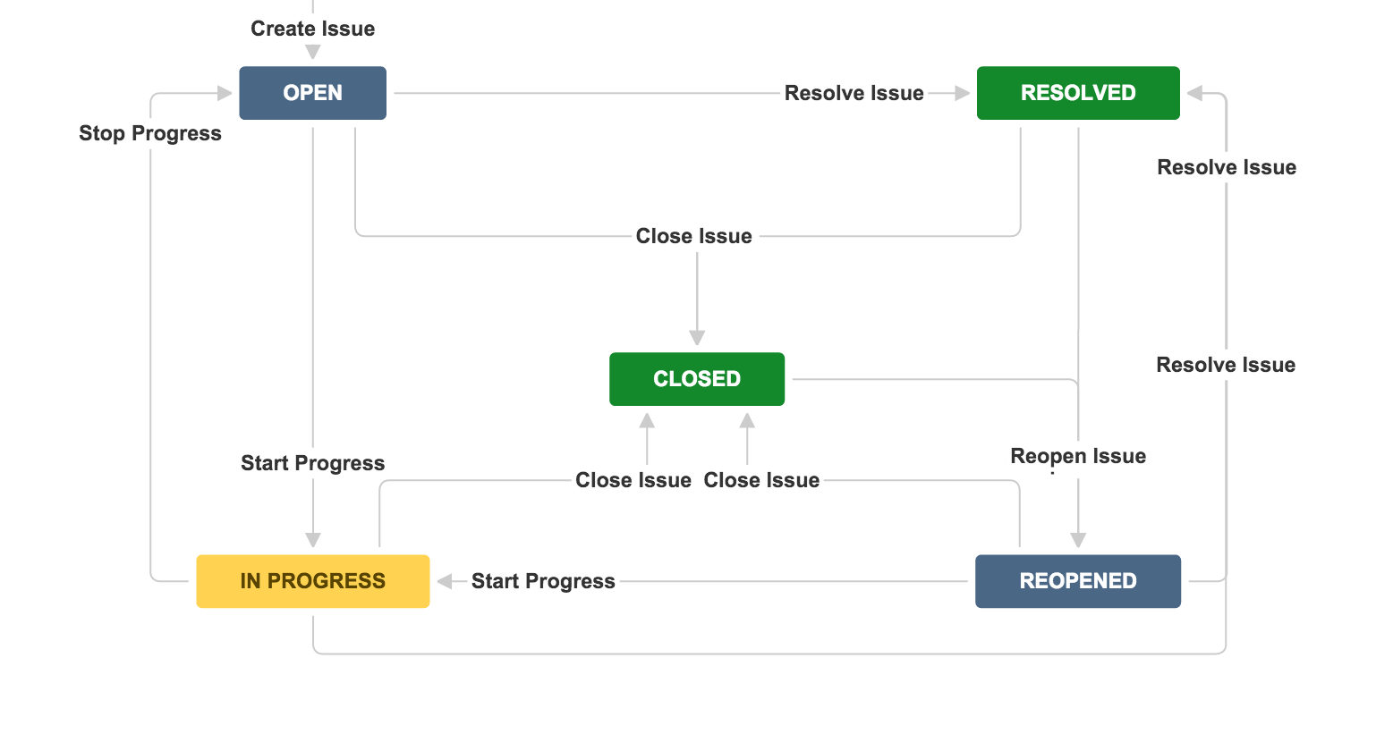

Slide 21

Companies that use JIRA

Slide 22

Thank you

